Slide 1
Host Hardening
Corporate Computer Security, 4th Edition
Randall J. Boyle & Raymond R. Panko
Chapter 7

Slide 2
Learning Objectives
Define the elements of host hardening, security baselines and images, and systems administration.
Know important server operating systems.
Describe vulnerabilities and patches.
Explain how to manage users and groups.
Explain how to manage permissions.
Know Windows client PC security, including centralized PC security management.
Explain how to create strong passwords.
Describe how to test for vulnerabilities.

Slide 3
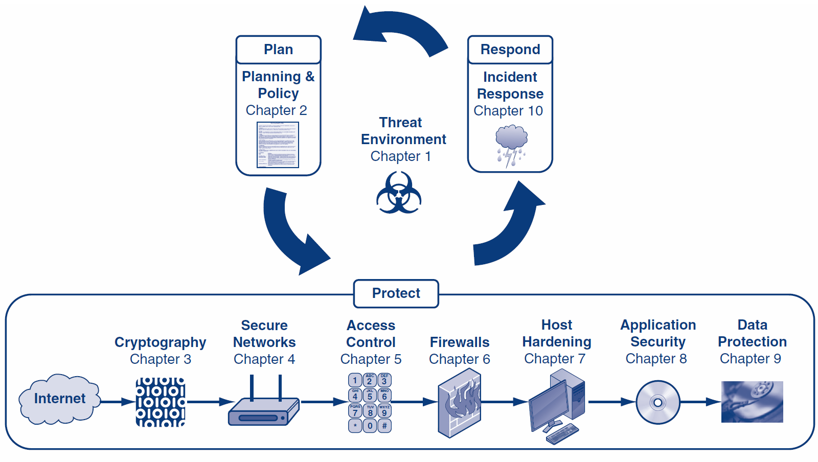

Slide 4
Orientation
Inevitably, some attacks will get through network safeguards and reach individual hosts
Host hardening is a series of actions taken to make hosts more difficult to take over
Chapter 7 focuses on host operating system hardening
Chapter 8 focuses on application protection

Slide 5
What’s Next?
7.1 Introduction
7.2 Important Server Operating Systems
7.3 Vulnerabilities and Patches
7.4 Managing Users and Groups
7.5 Managing Permissions
7.6 Creating Strong Passwords
7.7 Testing for Vulnerabilities

Slide 6
7.1: Threats to Hosts
The Problem
Some attacks inevitably reach host computers
So servers and other hosts must be hardened—a complex process that requires a diverse set of protections implemented on each host

Slide 7
7.1: Threats to Hosts
What Is a Host?
Anything with an IP address is a host (because it can be attacked)
Servers
Clients (including mobile telephones)
Routers (including home access routers) and sometimes switches
Firewalls

Slide 8
7.1: Elements of Host Hardening
Backup
Backup
Backup
Restrict physical access to hosts (see Chapter 5)
Install the operating system with secure configuration options
Change all default passwords, etc.

Slide 9
7.1: Elements of Host Hardening
Minimize the applications that run on the host
Harden all remaining applications on the host (see Chapter 8)
Download and install patches for operating vulnerabilities
Manage users and groups securely
Manage access permissions for users and groups securely

Slide 10
7.1: Elements of Host Hardening
Encrypt data if appropriate
Add a host firewall
Read operating system log files regularly for suspicious activity
Run vulnerability tests frequently

Slide 11
7.1: Security Baselines and Systems Administrators
Security Baselines Guide the Hardening Effort
Specifications for how hardening should be done
Needed because it is easy to forget a step
Different baselines for different operating systems and versions
Different baselines for servers with different functions (e.g., webservers, mail servers, etc.)
Used by systems administrators (server administrators)
Usually do not manage the network

Slide 12
7.1: Security Baselines and Systems Administrators
Security Baselines Guide the Hardening Effort
Disk Images
Can also create a well-tested secure implementation for each operating system version and server function
Save as a disk image
Load the new disk image on new servers

Slide 13
7.1: Virtualization
Multiple operating systems running independently on the same physical machine
System resources are shared
Increased fault tolerance
Rapid and consistent deployment
Reduced labor costs

Slide 14
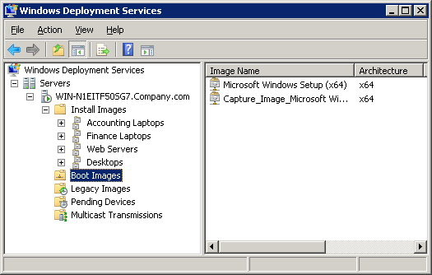
7.1: Windows Deployment Services

Slide 15
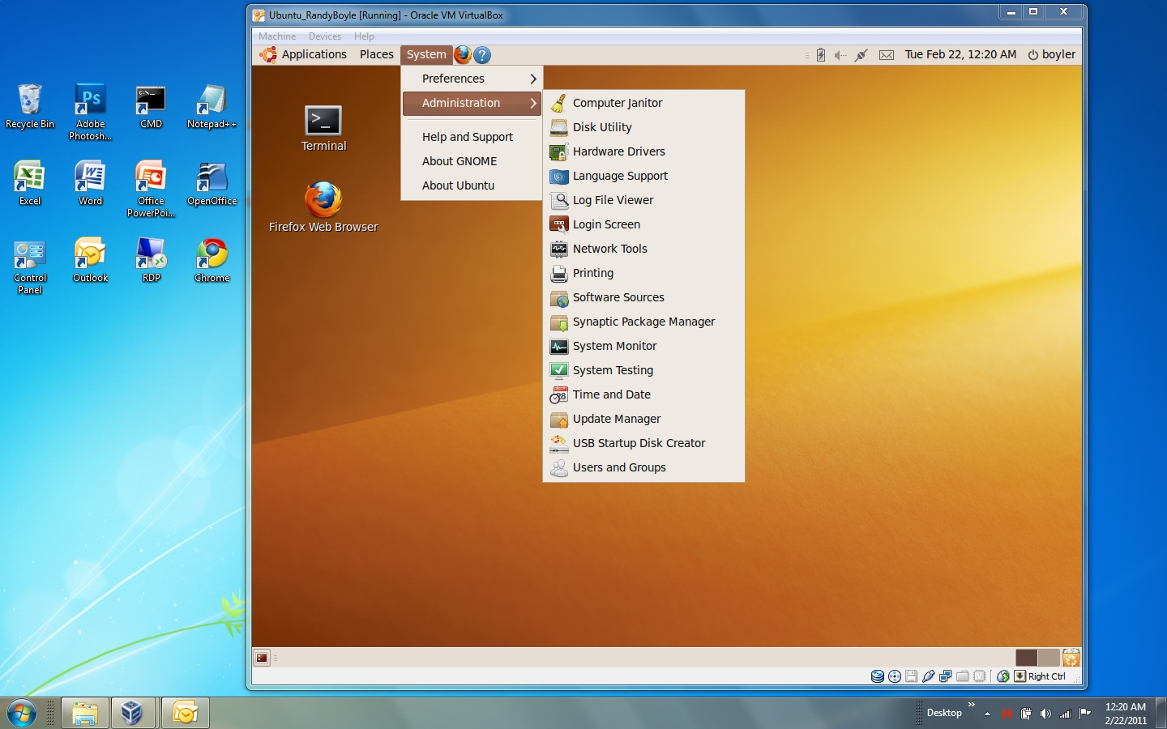
7.1: Linux Virtual Machine

Slide 16
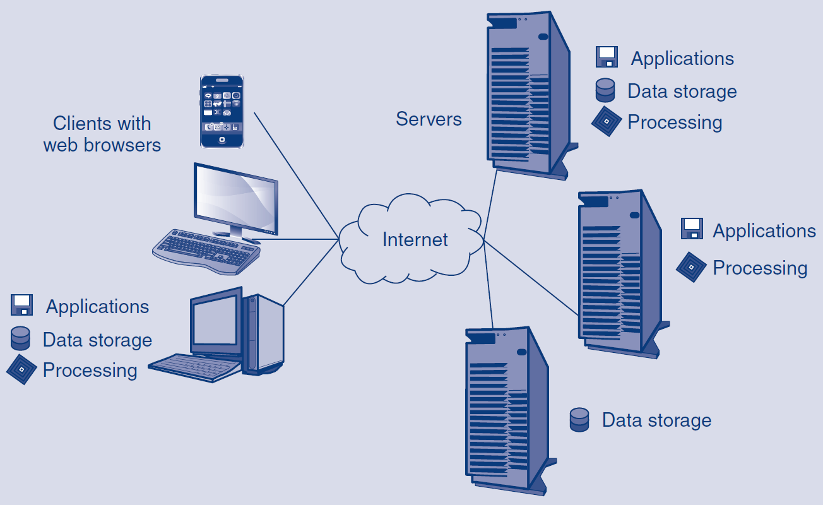
7.1: Cloud Computing

Slide 17
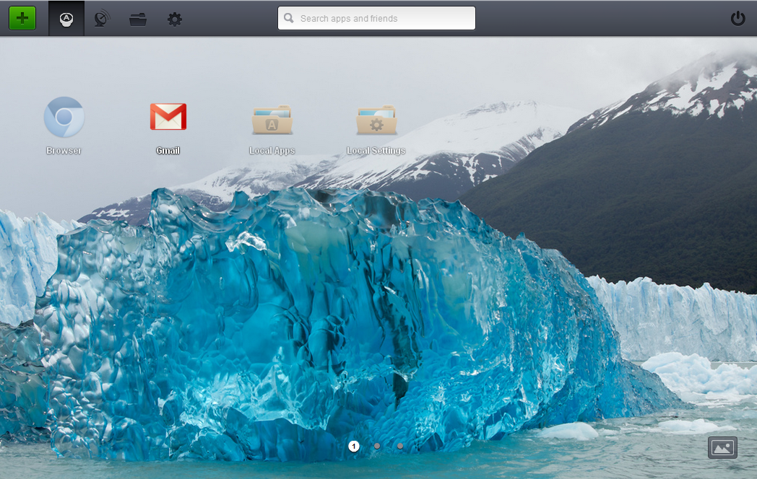
7.1: Jolicloud Desktop

Slide 18
What’s Next?
7.1 Introduction
7.2 Important Server Operating Systems
7.3 Vulnerabilities and Patches
7.4 Managing Users and Groups
7.5 Managing Permissions
7.6 Creating Strong Passwords
7.7 Testing for Vulnerabilities

Slide 19
7.2: Windows Server Operating Systems
Windows Server
The Microsoft Windows Server operating system
Windows NT, Windows Server 2003, and Windows Server 2008
Windows Server Security
Intelligently minimize the number of running programs and utilities by asking questions during installation
Simple (and usually automatic) to get updates
Still many patches to apply, but this is true of other operating systems

Slide 20
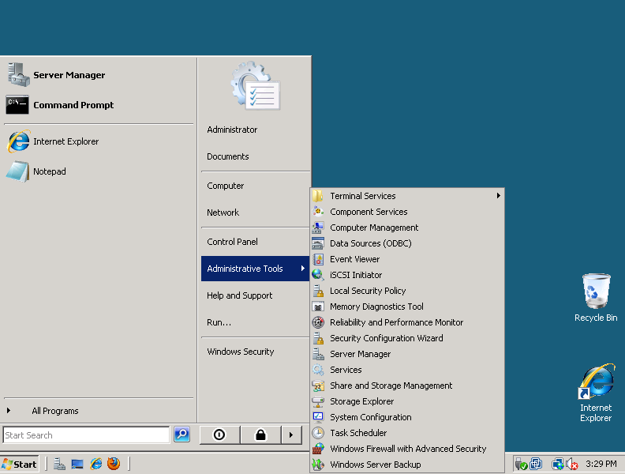
7.2: Windows 2008 Server User Interface
Looks like client
versions of Windows
Ease of learning and use
Choose Administrative Tools
for most programs
Tools are called
Microsoft Management
Consoles (MMCs)
Copyright Pearson Prentice-Hall 2013

Slide 21
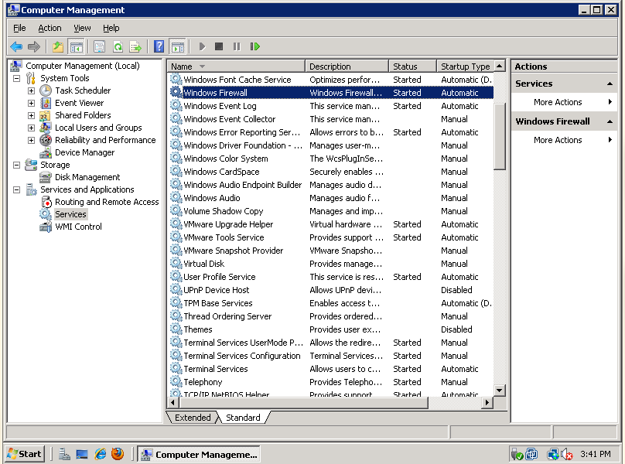
7.2: Computer Management Microsoft Management Console (MMC)
Name of MMC (Computer Management)
Pane with objects under Services (Windows Firewall selected)
Tree pane with snap-ins (Services selected)
MMCs have standard
user interfaces

Slide 22
7.2: UNIX Operating Systems
UNIX
Many Versions of UNIX
There are many commercial versions of UNIX for large servers
Compatible in the kernel (core part) of the operating system
Can generally run the same applications
May run many different management utilities, making cross-learning difficult

Slide 23
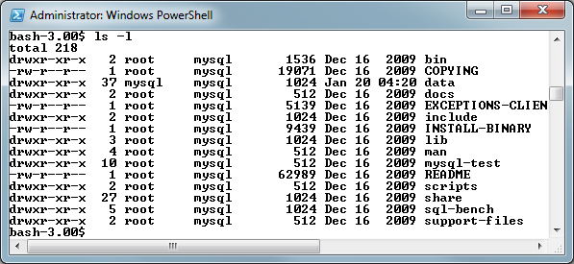
7.2: UNIX Terminal

Slide 24
7.2: UNIX Operating Systems
Many Versions of UNIX
LINUX is a version of UNIX created for PCs
Many different LINUX distributions
Distributions include the LINUX kernel plus application and programs, usually from the GNU project
Each distribution and version needs a different baseline to guide hardening

Slide 25
7.2: UNIX Operating Systems
Many Versions of UNIX
LINUX is a version of UNIX created for PCs
Free or inexpensive to buy
May take more labor to administer
Has moved beyond PC, to use on servers and some desktops
LINUX

Slide 26
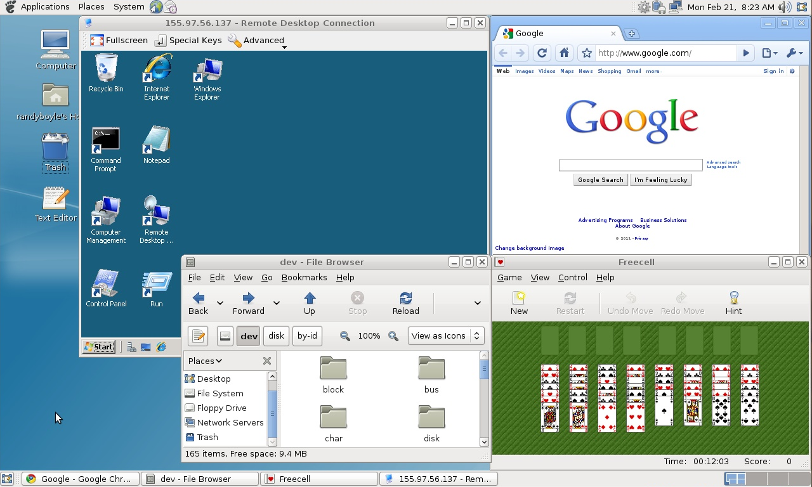
7.2: Debian® Linux Desktop

Slide 27
7.2: UNIX Operating Systems
User Can Select the User Interface
Multiple user interfaces are available (unlike Windows)
Graphical user interfaces (GUIs)
Command line interfaces (CLIs)
At prompts, users type commands
Unix CLIs are called shells (Bourne, BASH, etc.)
>ls -1
…

Slide 28
What’s Next?
7.1 Introduction
7.2 Important Server Operating Systems
7.3 Vulnerabilities and Patches
7.4 Managing Users and Groups
7.5 Managing Permissions
7.6 Creating Strong Passwords
7.7 Testing for Vulnerabilities

Slide 29
7.3: Vulnerabilities and Exploits
Vulnerabilities
Security weaknesses that open a program to attack
An exploit takes advantage of a vulnerability
Vendors develop fixes
Zero-day exploits: exploits that occur before fixes are released
Exploits often follow the vendor release of fixes within days or even hours
Companies must apply fixes quickly

Slide 30
7.3: Vulnerabilities and Exploits
Fixes
Work-arounds
Manual actions to be taken
Labor-intensive, so expensive and error-prone
Patches:
Small programs that fix vulnerabilities
Usually easy to download and install
Service packs (groups of fixes in Windows)
Version upgrades

Slide 31
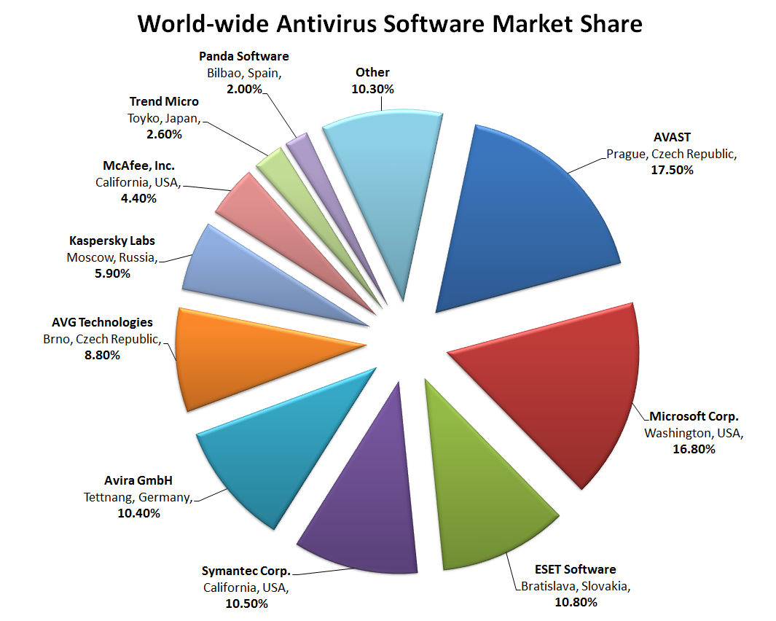
7.3: Worldwide Antivirus Software Market Share

Slide 32
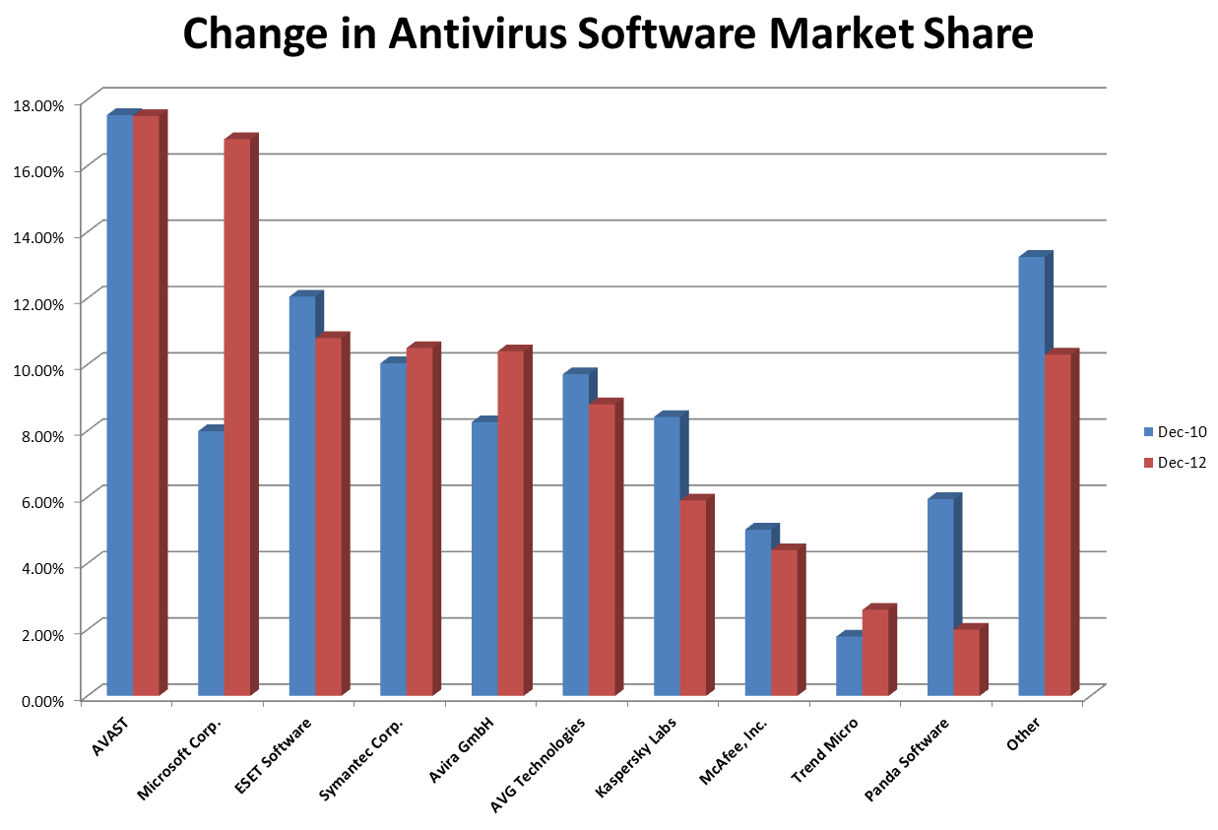
7.3: Change in Antivirus Software Market Share

Slide 33
7.3: Applying Patching
Problems with Patching
Must find operating system patches
Windows Server does this automatically
LINUX versions often use rpm
Companies get overwhelmed by number of patches
Use many programs; vendors release many patches per product
Especially a problem for a firm’s many application programs

Slide 34
7.3: Applying Patching
Problems with Patching
Cost of patch installation
Each patch takes time and labor costs
Usually lack the resources to apply all
Prioritization
Prioritize patches by criticality
May not apply all patches if risk analysis does not justify them

Slide 35
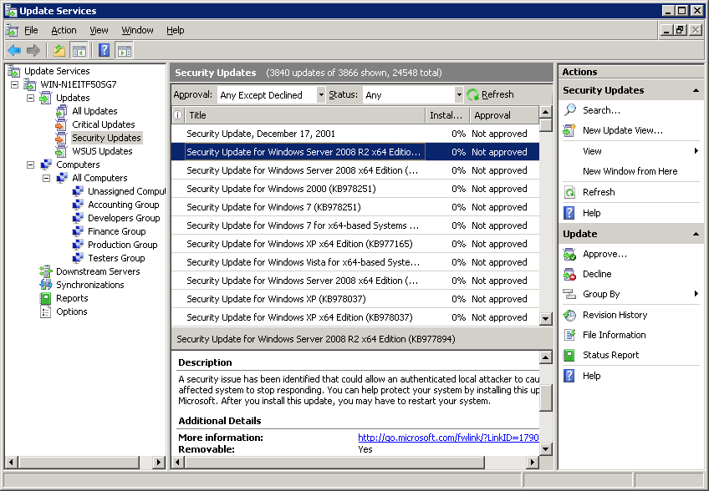
7.3: Windows Server Update Services

Slide 36
7.3: Applying Patching
Problems with Patching
Risks of patch installation
Reduced functionality
Freezes machines, does other damage—sometimes with no uninstall possible
Should test on a test system before deployment on servers

Slide 37
What’s Next?
7.1 Introduction
7.2 Important Server Operating Systems
7.3 Vulnerabilities and Patches
7.4 Managing Users and Groups
7.5 Managing Permissions
7.6 Creating Strong Passwords
7.7 Testing for Vulnerabilities

Slide 38


7.4: Managing Users and Groups
XYZ
Accounts
Every user must have an account
Groups
Individual accounts can be consolidated into groups
Can assign security measures to groups
Inherited by each group’s individual members
Reduces cost compared to assigning to individuals
Reduces errors
XYZ

Slide 39
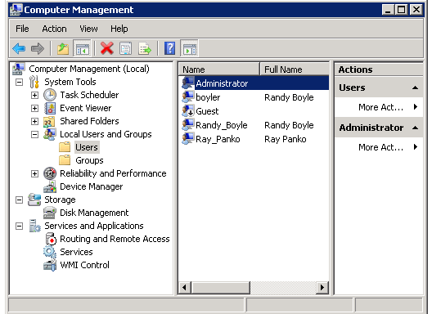
7.4: Users and Groups in Windows
2.
Select a
particular user
1.
Select Users
or Groups
Right-click.
Select properties.
Change selected properties.

Slide 40
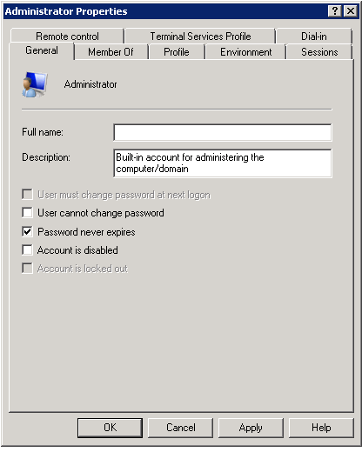
7.4: Windows User Account Properties
Member Of tab for adding user to groups
General tab for the Administrator
Account
selected
Password and Account actions

Slide 41
7.4: The Super User Account
Super User Account
Every operating system has a super user account
The owner of this account can do anything
Called “Administrator” in Windows
Called “root” in UNIX
Hacking Root
Goal is to take over the super user account
Will then “own the box”
Generically called “hacking root”

Slide 42
7.4: The Super User Account
Appropriate Use of a Super User Account
Log in as an ordinary user
Switch to super user only when needed
In Windows, the command is RunAs
In UNIX, the command is su (switch user)
Quickly revert to ordinary account when super user privileges are no longer needed

Slide 43
What’s Next?
7.1 Introduction
7.2 Important Server Operating Systems
7.3 Vulnerabilities and Patches
7.4 Managing Users and Groups
7.5 Managing Permissions
7.6 Creating Strong Passwords
7.7 Testing for Vulnerabilities

Slide 44
7.5: Managing Permissions in Windows
Permissions
Specifies what the user or group can do to files, directories, and subdirectories
Assigning Permissions in Windows
Right-click on file or directory
Select Properties, then Security tab
Select a user or group
Select the 6 standard permissions (permit or deny)
For more fine-grained control, 13 special permissions

Slide 45
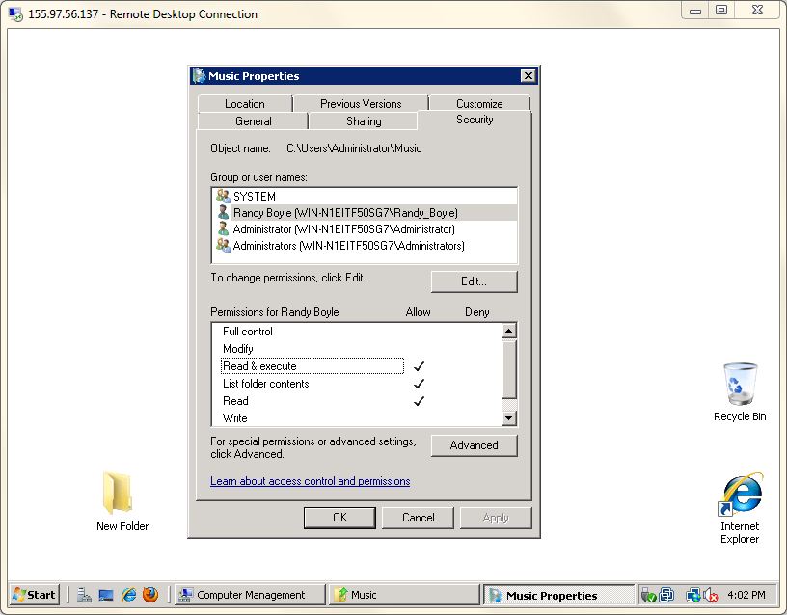
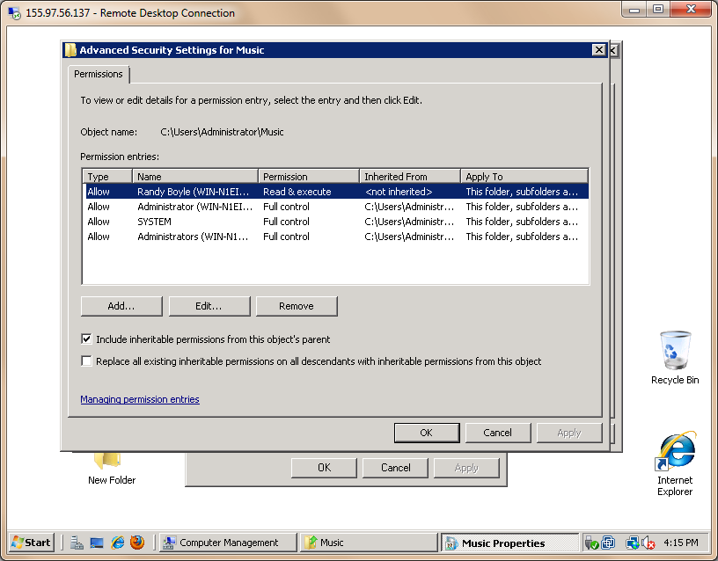
7.5: Assigning Permissions in Windows
Select a user or group
Inheritable permissions
Standard permissions
Advanced permissions

Slide 46
7.5: The Inheritance of Permission
Inheritance
If the Include inheritable permissions from this object’s parent is checked in the security tab, the directory receives the permissions of the parent directory.
This box is checked by default, so inheritance from the parent is the default.

Slide 47

7.5: The Inheritance of Permission
XYZ
Inheritance
Total permissions include
Inherited permissions (if any)
Plus the Allow permissions checked in the Security tab
Minus the Deny permissions checked in the Security tab
The result is the permissions level for a directory or file
XYZ

Slide 48
7.5: The Inheritance of Permission
Directory Organization
Proper directory organization can make inheritance a great tool for avoiding labor
Example: Suppose the all logged-in user group is given Read and Execute permissions in the public programs directory
Then all programs in this directory and its subdirectories will have Read and Execute permissions for everyone who is logged in
There is no need to assign permissions to subdirectories and their files

Slide 49
7.5: Assigning Permissions in Windows and UNIX
Category | Windows | UNIX
Number of permissions | 6 standard, 13 specialized if needed | Only 3: Read (read only), Write (make changes), and Execute (for programs). Referred to as “rwx”
For a file or directory, different permissions can be assigned | Any number of individual accounts and groups | The account owner A single group All other accounts

Slide 50
What’s Next?
7.1 Introduction
7.2 Important Server Operating Systems
7.3 Vulnerabilities and Patches
7.4 Managing Users and Groups
7.5 Managing Permissions
7.6 Creating Strong Passwords
7.7 Testing for Vulnerabilities

Slide 51
7.6: Password Policies
Password Strength Policies (from Chapter 5)
Password policies must be long and complex
At least 8 characters long
Change of case, not at beginning
Digit (0 through 9), not at end
Other keyboard character, not at end
Example: tri6#Vial

Slide 52
7.6: Creating Password Hash
Password is hashed and then stored
Plaintext: 123456
MD5 Hash: E10ADC3949BA59ABBE56E057F20F883E
Windows password hashes are stored in the security accounts manager (SAM)
Shadow files separate password hashes from other user information and restrict access

Slide 53
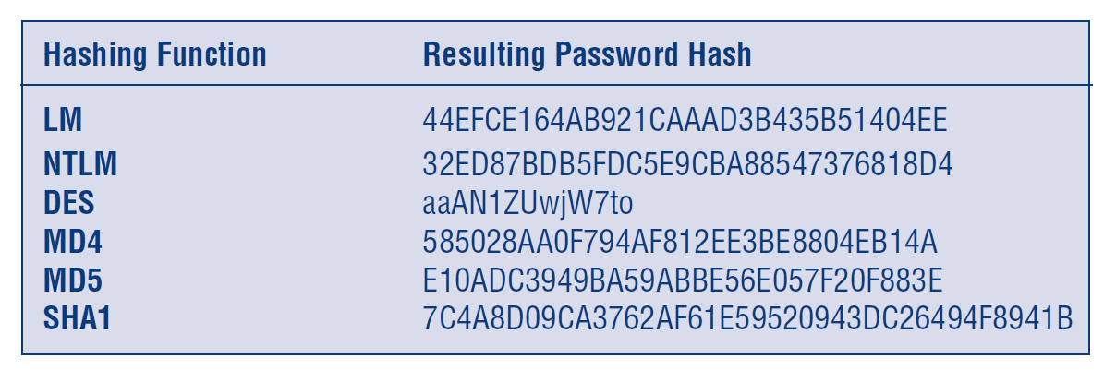
7.6: Password Hashes for “123456”

Slide 54
7.6: Brute-Force Guessing
Try all possible passwords
Try all 1-character passwords (e.g., a, b, c)
Try all 2-character passwords (e.g., aa, ab, bb)
Etc.
Broader character set increases the number of possible combinations
Password length increases the number of possible combinations

Slide 55
7.6: Password Complexity and Length are Both Crucial
Password Length in Characters | Low Complexity: Alphabetic, No Case (N=26) | Alphabetic, Case-Sensitive (N=52) | Alphanumeric: Letters and Digits (N=62) | High Complexity: All Keyboard Characters (N=80)
1 | 26 | 52 | 62 | 80
2 | 676 | 2,704 | 3,844 | 6,400
4 | 456,976 | 7,311,616 | 14,776,336 | 40,960,000
6 | 308,915,776 | 19,770,609,664 | 56,800,235,584 | 2.62144E+11
8 | 2.08827E+11 | 5.34597E+13 | 2.1834E+14 | 1.67772E+15
10 | 1.41167E+14 | 1.44555E+17 | 8.39299E+17 | 1.07374E+19
Note: On average, an attacker will have to try half of all combinations.

Slide 56
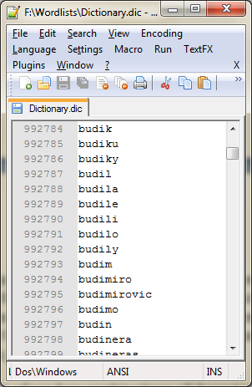
7.6: Sample Dictionary File

Slide 57
7.6: Dictionary Attacks
Dictionary attacks
Many people do not choose random passwords
Dictionary attacks on common word passwords are almost instantaneous
Names of people, places, pets
Names of sports teams, music, slang, dates, phone numbers, profanity, etc.

Slide 58
7.6: Hybrid Dictionary Attacks
Mangling Rules:
• Adding numbers (1password, password1, 1492password, etc.)
• Reverse spelling (drowssap)
• Entering the password twice (passwordpassword)
• Trying the password with changes in case (PaSsWoRd)
• Using leet “l337” spellings (pa55word)
• Deleting characters (pswrd)
• Trying key patterns (asdfghjkl;, qwertyuiop, etc.)
• Adding all prefixes and suffixes (passworded, postpassword)
• Trying derivations of username, e-mail, or other account information contained in the password file

Slide 59
7.6: Rainbow Tables
List of pre-computed password hashes
Results in a time-memory tradeoff
More memory used to store rainbow tables
The time required to crack a password is greatly reduced

Slide 60
7.6: Truly Random Passwords
Almost impossible for users to memorize
Users tend to write them down
Administrator accounts must use long, random passwords
Copies of administrator account passwords must be written down and securely stored
Testing and enforcing password policies

Slide 61
7.6: Other Password Threats
Other Password Threats
Keystroke Capture Software
Trojan horse displays a fake login screen, reports its findings to attackers
Shoulder Surfing
Attacker watches as the victim types a password
Even partial information can be useful
Part of the password: P_ _sw_ _d
Length of the password (reduces time to do brute-force cracking)

Slide 62
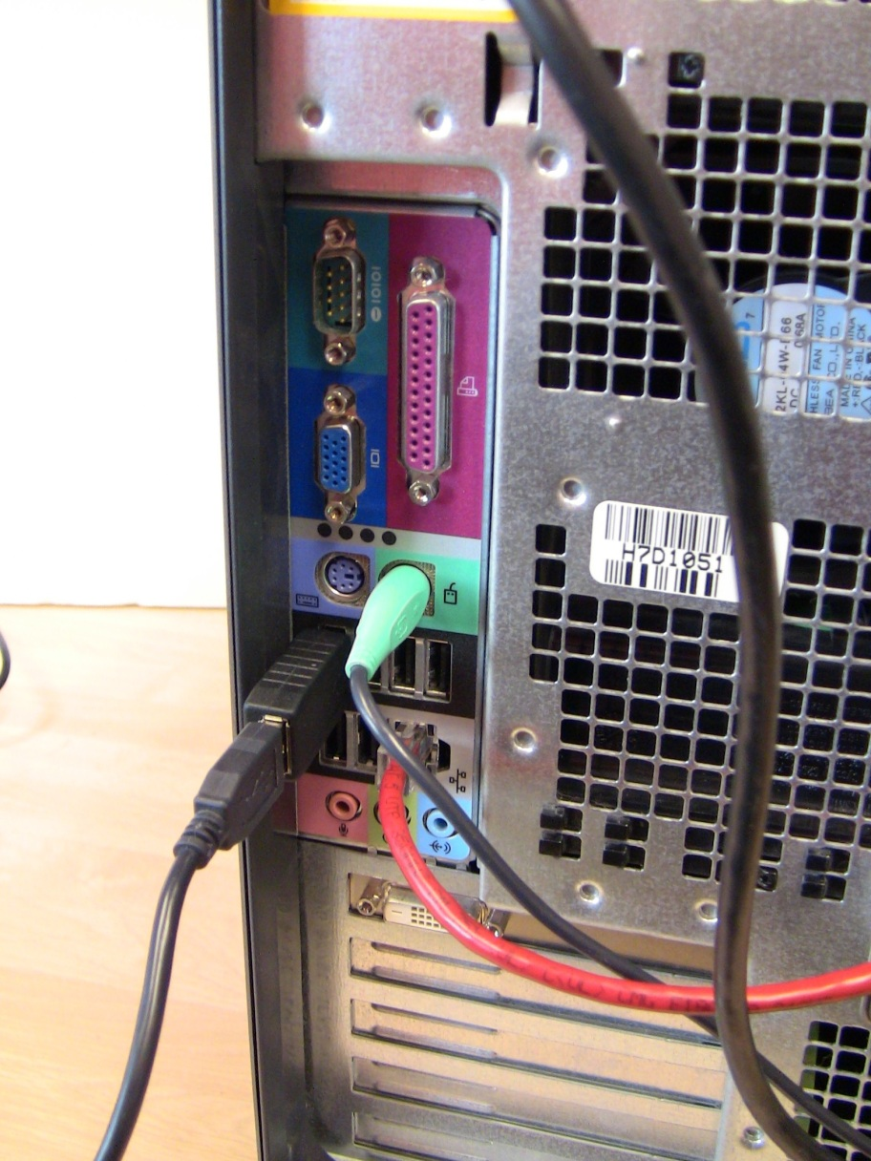
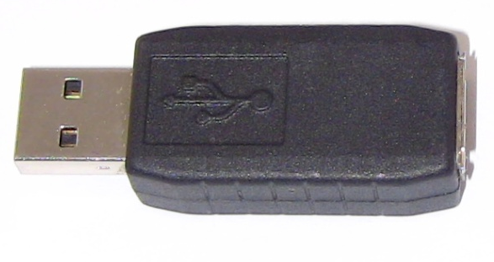
7.6: Physical Keylogger
Physical USB Keylogger

Slide 63
What’s Next?
7.1 Introduction
7.2 Important Server Operating Systems
7.3 Vulnerabilities and Patches
7.4 Managing Users and Groups
7.5 Managing Permissions
7.6 Creating Strong Passwords
7.7 Testing for Vulnerabilities

Slide 64
7.7: Vulnerability Testing
Mistakes Will Be Made in Hardening
Do vulnerability testing
Run Vulnerability Testing Software on Another Computer
Run the software against the hosts to be tested
Interpret the reports about problems found on the server
This requires extensive security expertise
Fix them

Slide 65
7.7: Vulnerability Testing
Get Permission for Vulnerability Testing
Looks like an attack
Must get prior written agreement
Vulnerability testing plan
An exact list of testing activities
Approval in writing to cover the tester
Supervisor must agree, in writing, to hold the tester blameless if there is damage
Tester must not diverge from the plan

Slide 66
7.7: Windows Client PC Security
Client PC Security Baselines
For each version of each operating system
Within an operating system, for different types of computers (i.e., desktop versus notebook, on-site versus external, high-risk versus normal risk, etc.)
Automatic Updates for Security Patches
Completely automatic updating is the only reasonable policy

Slide 67
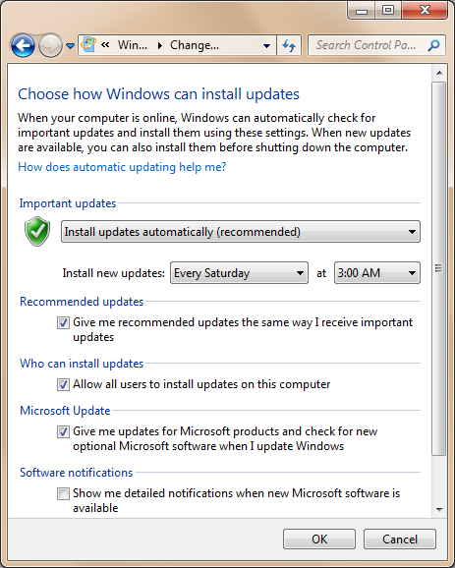
7.7: Windows Update Settings
Set updates to install automatically
Set a day/time that will minimize any inconvenience

Slide 68
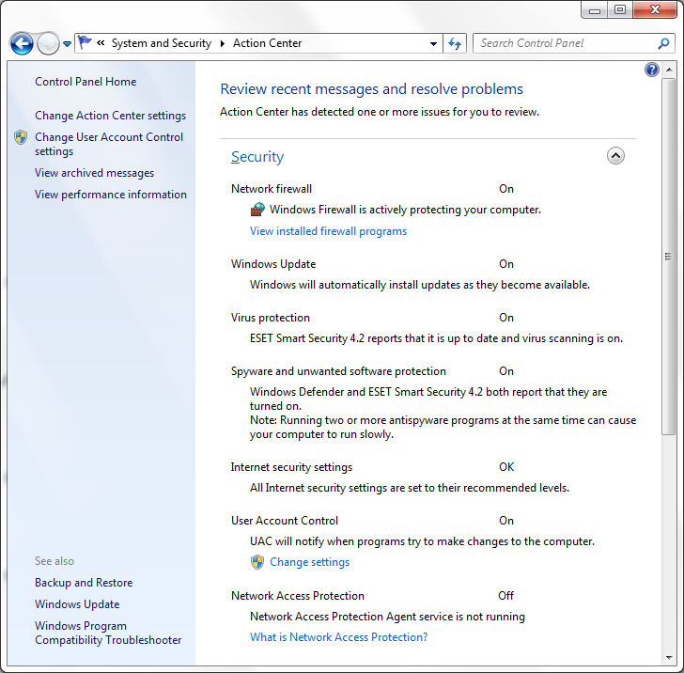
7.7: Windows Action Center
Central location to check security settings, including:
Windows Firewall
Windows Update
Virus Protection
Spyware Protection
Internet Security Settings
User Account Control
Network Access Protection

Slide 69
7.7: Windows Client PC Security
Antivirus and Antispyware Protection
Important to know the status of antivirus protection
Users turn on or turn off automatic updating for virus signatures
Users do not pay the annual subscription, so they do not get more updates
Windows Advanced Firewall
Stateful inspection firewall
Accessed through the Windows Action Center

Slide 70
7.7: Implementing Security Policy
Enable local password policies
Minimum password length
Maximum password age
Implement basic account policies
Prevents attackers from endlessly trying to guess a user’s password
Implement audit policy for system events
Attempts to disable security protections or changes in permissions

Slide 71
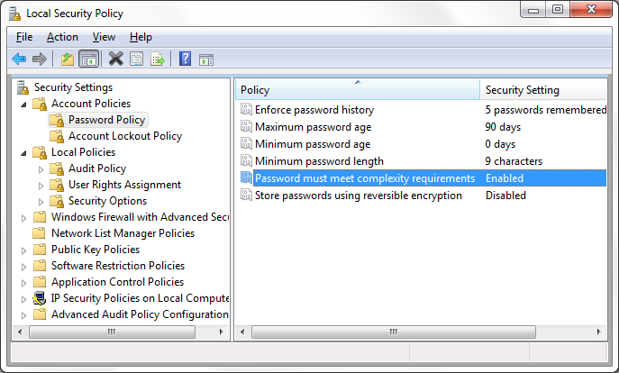
7.7: Windows Local Password Policy

Slide 72
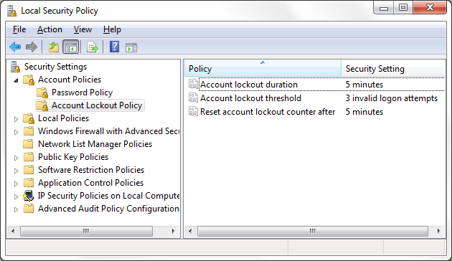
7.7: Windows Account Policy

Slide 73
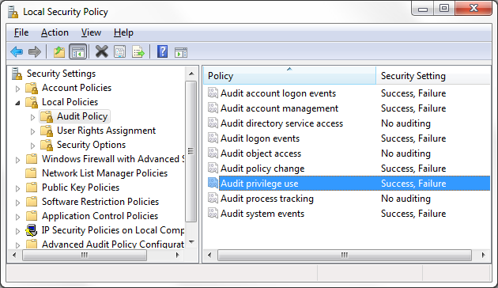
7.7: Windows Audit Policy

Slide 74
7.7: Protecting Notebook Computers
Threats
Loss or theft
Loss of capital investment
Loss of data that was not backed up
Loss of trade secrets
Loss of private information, perhaps leading to lawsuits

Slide 75
7.7: Protecting Notebook Computers
Backup
Before taking the notebook out
Frequently, during use outside the firm
Use a Strong Password
If attackers bypass the operating system password, they get open access to encrypted data
The loss of login passwords is a major concern

Slide 76
7.7: Protecting Notebook Computers
Policies for Sensitive Data
Four main policies:
Limit what sensitive data can be stored on all mobile devices
Require data encryption for all data
Protect the notebook with a strong login password
Audit for the previous two policies
Apply policies to all mobile data on disk drives, USB RAM drives, MP3 players that store data, and even mobile phones that can store data

Slide 77
7.7: Protecting Notebook Computers
Other Measures
Teach users loss and theft protection techniques
Use notebook recovery software
Contacts the recovery company the next time the computer connects to the Internet
Recovery company contacts local police to recover the software

Slide 78
7.7: Centralized PC Security Management
Importance
Ordinary users lack the knowledge to manage security on their PCs
They sometimes knowingly violate security policies
Centralized management can often reduce costs through automation

Slide 79
7.7: Centralized PC Security Management
Standard Configurations for PCs
May restrict applications, configuration settings, and even the user interface
Ensure that the software is configured safely
Enforce policies
More generally, reduce maintenance costs by making it easier to diagnose errors

Slide 80
7.7: Centralized PC Security Management
Network Access Control (NAC)
Goal is to reduce the danger created by computers with malware
Control their access to the network

Slide 81
7.7: Centralized PC Security Management
Network Access Control (NAC)
Stage 1: Initial Health Check
Checks the “health” of the computer before allowing it into the network
Choices:
Accept it
Reject it
Quarantine and pass it to a remediation server; retest after remediation

Slide 82
7.7: Centralized PC Security Management
Network Access Control (NAC)
Stage 2: Ongoing Traffic Monitoring
If traffic after admission indicates malware on the client, drop or remediate
Not all NAC systems do this

Slide 83
7.7: Windows Group Policy Objects (GPOs)
Advantages of GPOs
Consistency −Security policy can be applied across an entire organization uniformly at the same time
Reduced Administrative Costs − Corporate policies can be created, applied, and managed from a single management console
Compliance − A company can ensure compliance with laws and regulations
Control − Provides a granular level of control over users, computers, applications, and tasks

Slide 84
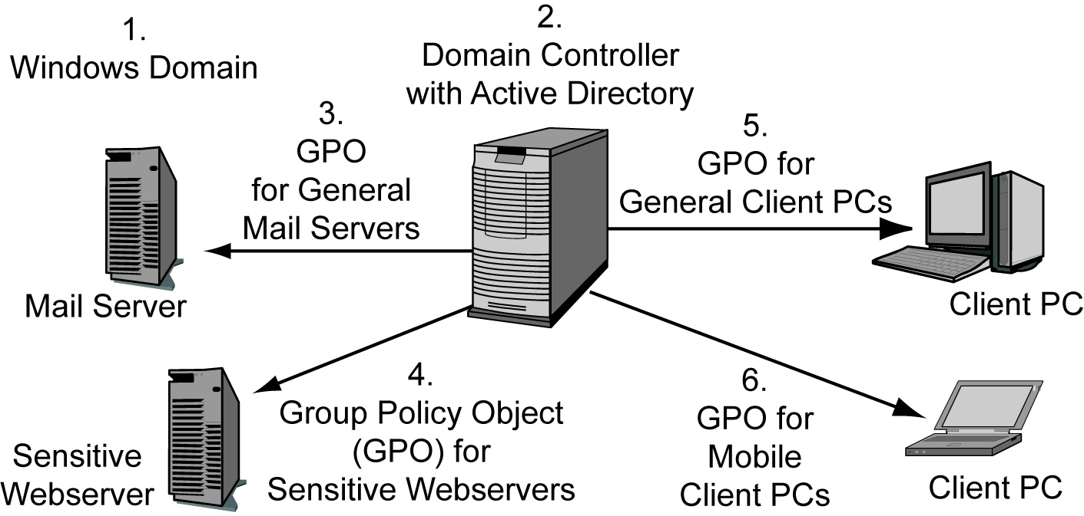
7.7: Windows Group Policy Objects (GPOs)

Slide 85
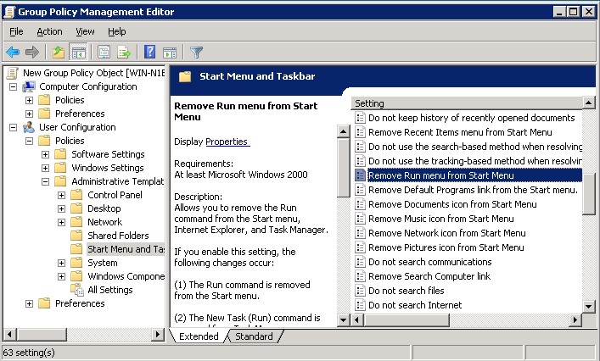
7.7: Windows Group Policy Objects (GPOs)

Slide 86
The End

Slide 87
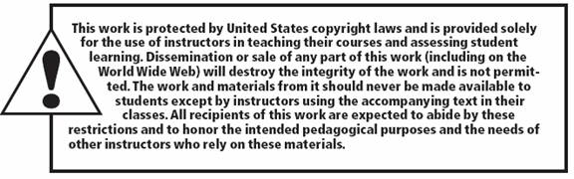
All rights reserved. No part of this publication may be reproduced, stored in a retrieval system, or transmitted, in any form or by any means, electronic, mechanical, photocopying, recording, or otherwise, without the prior written permission of the publisher. Printed in the United States of America.
Copyright © 2015 Pearson Education, Inc.

